Slide 1
Alternative Intertemporal Choice Models

Slide 2
Habit-formation models
Rooted in Dusenberry’s ‘Relative income hypothesis’
Ut = f(Ct, Ct–1, Ct–2,…)
All the values of past consumption are combined together into a composite variable, Zt, that may be exponentially weighted to give more importance to more recent periods, and that is increasing with past consumption.
Ut = f(Ct, Zt)
Thus the more a person has consumed in the past the more utility current consumption will yield, causing the person to consume more now.

Slide 3
Continued...
Implications:
Shifting the reference points
Diminishing marginal sensitivity

Slide 4
Prospect theory models
Uncertain future gains: people are risk averse for gains- preference of immediate gains over future gains: bonds, social security
Uncertain future losses: risk seeking for losses: immediate loses over future loses: insurance, pre-paid plans

Slide 5
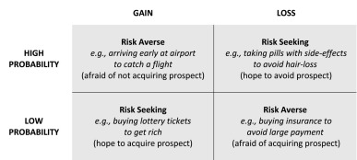

Slide 6
Anticipatory utility models
People derive utility from anticipation of future consumption as well as from current and past consumption.
Ut = f(Ct, Ct+1, Ct+2,…)
This phenomenon works in the opposite direction to the normal direction of time preference, for both gains and losses.
Exceptions: waiting for a good outcome can be frustrating, while one may prefer to delay the possibility of a bad outcome to avoid spoiling the weekend.

Slide 7
Visceral influence models
The temporal proximity of an outcome may increase its desirability which may cause a higher rate of discount to be computed for near-future outcomes when factors like anger, hunger, lust and sleeplessness are involved.
Biases:
Immediacy bias
Paradox of ‘not wanting to want’

Slide 8
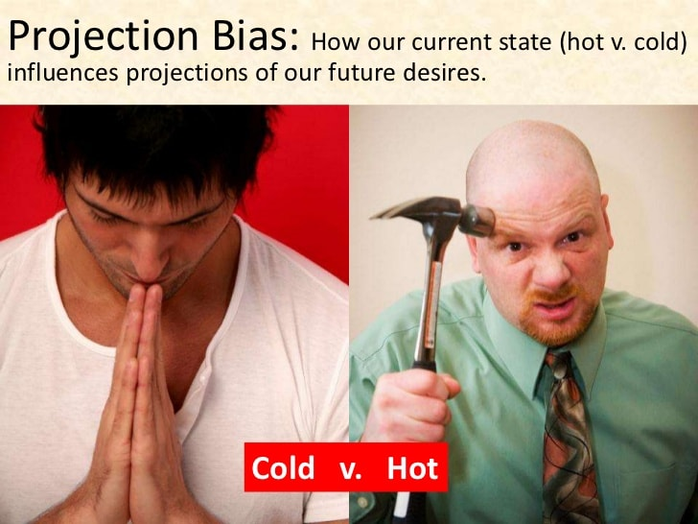
Projection bias models

Slide 9
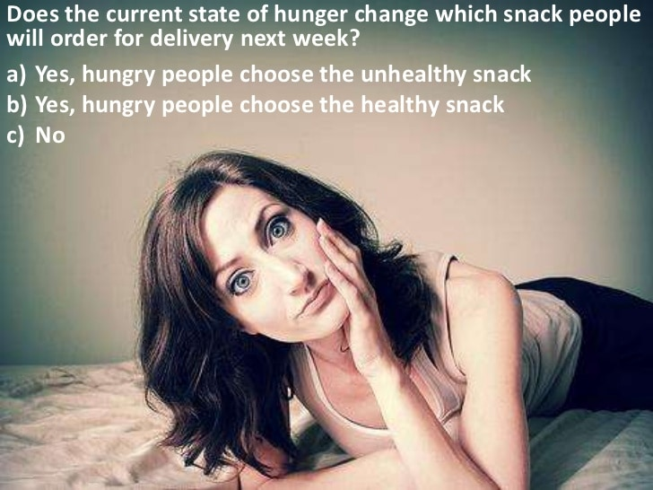

Slide 10
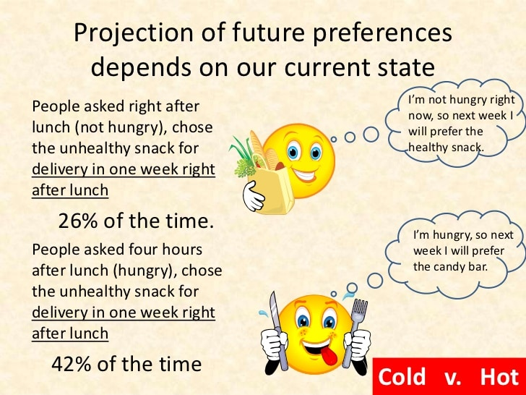

Slide 11
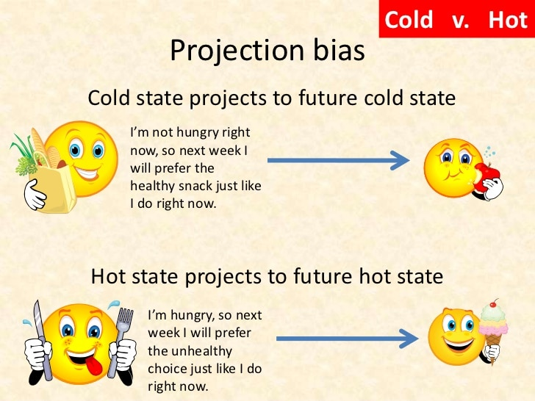

Slide 12
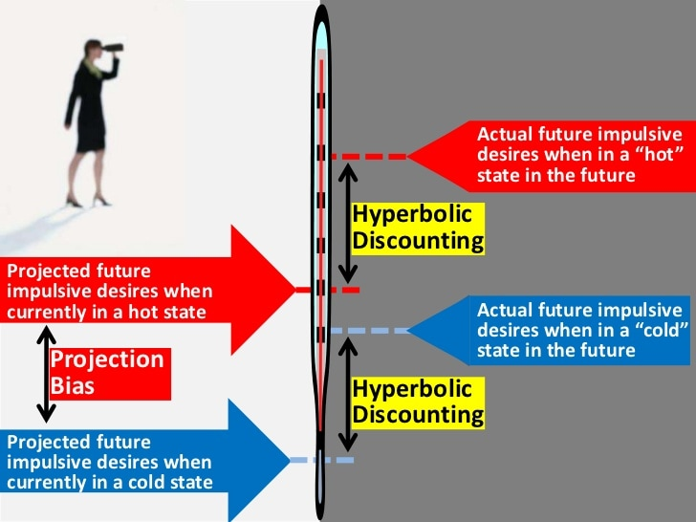

Slide 13
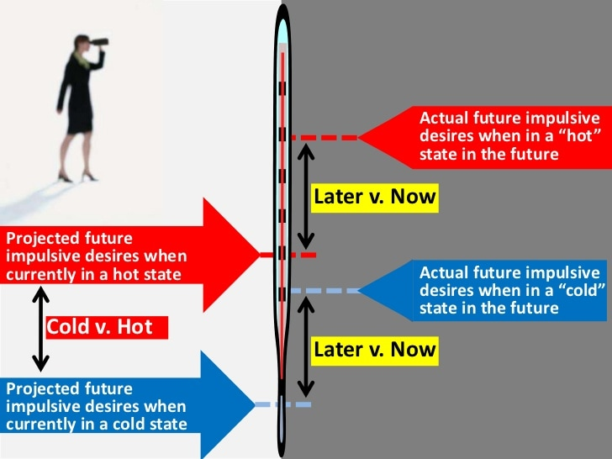

Slide 14
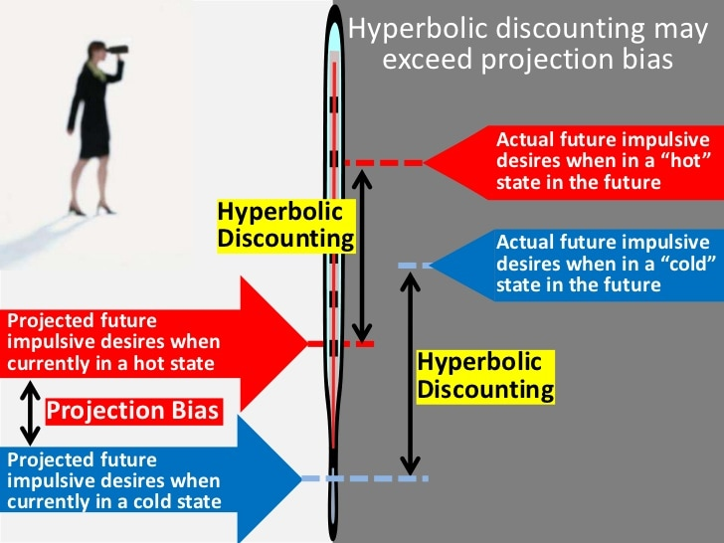

Slide 15
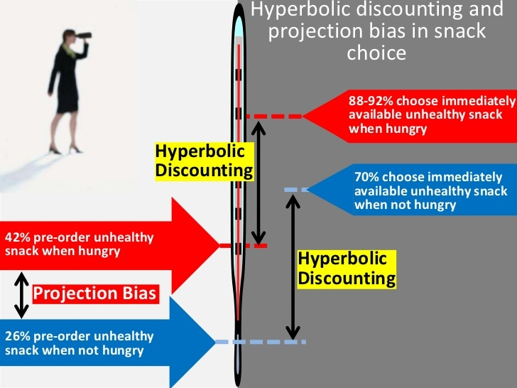

Slide 16
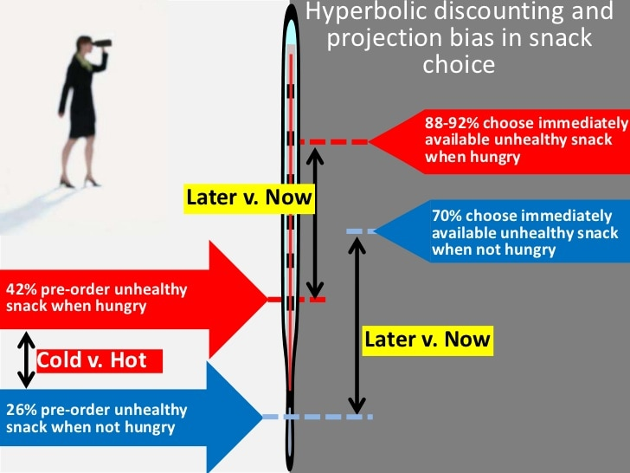

Slide 17
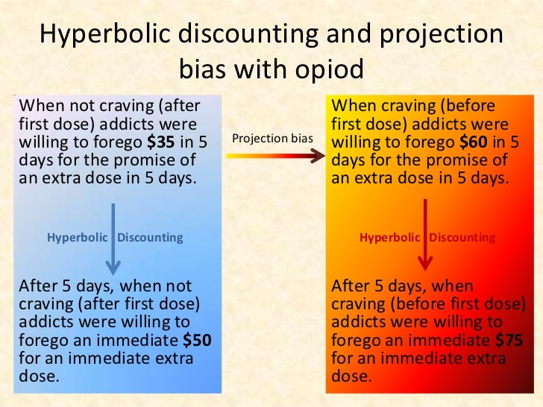

Slide 18
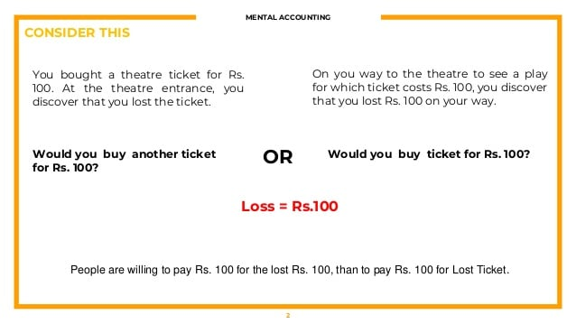
Mental accounting models

Slide 19


Slide 20
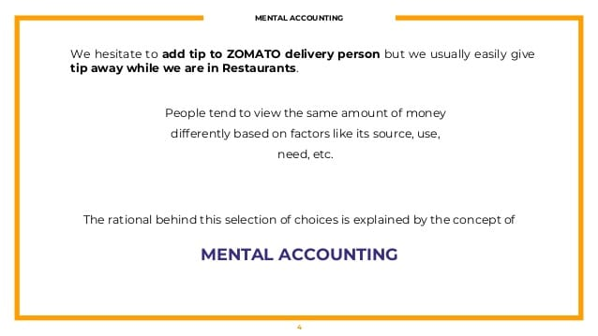

Slide 21


Slide 22
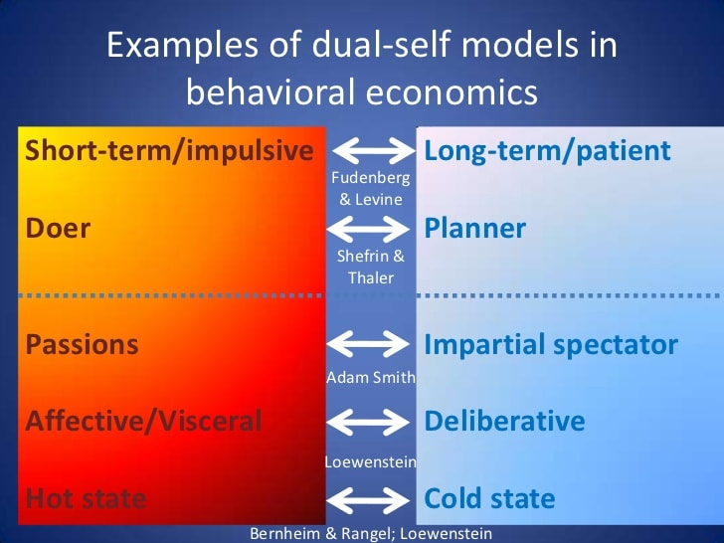
Dual Self Models

Slide 23
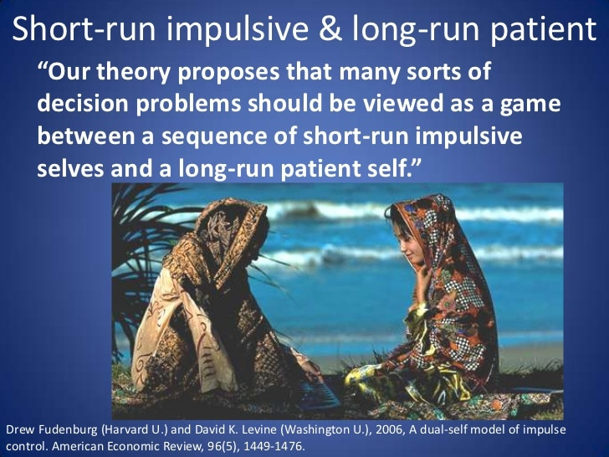

Slide 24
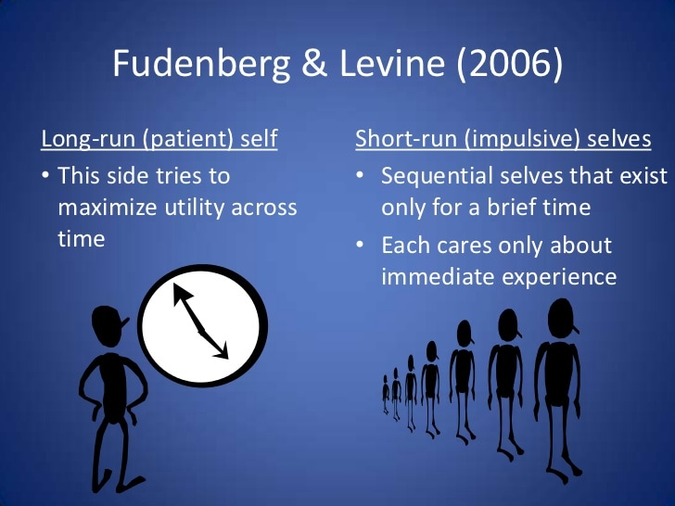

Slide 25
Policy Implications
Individuals
Self awareness: commitments
Firms
Firms should price investment goods below marginal cost.
Firms should price leisure goods above marginal cost.
Firms should charge back-loaded fees and introduce switching costs for all goods.
Government
incomplete self-knowledge,
addiction,
savings,
investment,
social projects and
environmental policy

